Slide 1

Introduction BRM Gen1
2020-12-22

Slide 2
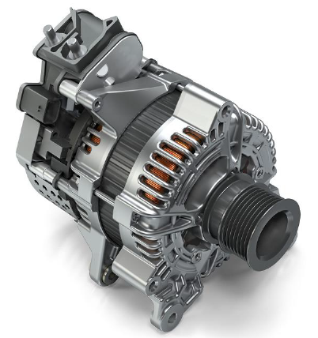
Overview
Header of section
Operation points
  Torque control
  Speed control
  Voltage control
Typical voltages
  B+/B- bolts (48V connection) = 36 – 52V
  12V supply on logic connector = 8 - 14V
Speed range
  Motor (positive) torque: 0 – 10.000rpm
    Torque up to 54Nm
  Generator (negative) torque: 0 – 18.000rpm
    Torque up to -42Nm
B+
B-
Logic connector
2
SG/EEB3 | 2020-12-22
© SEG Automotive Germany GmbH 2020. All rights reserved, also regarding any disposal, exploitation, reproduction, editing, distribution, as well as in the event of applications for industrial property rights.

Slide 3
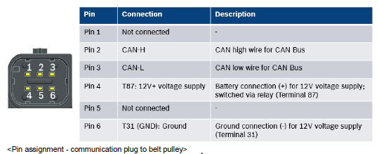
Connections
Logic connector
Header of section
Pin 2
Pin 3
Pin 4
See SW interface description page 7 and 8
CAN Termination resistor
Important!!!
Pin 6
B+
CAN controller
(for example Vector CANoe)
CAN High
120 Ohm
B-
CAN Low
Logic connector
12V
12V
12V typical consumption approx. 300mA w/o 48V connection
50mA w/ 48V connection
12V - Ground
48V
48V
48V - Ground
Important!!!
12V Ground must always connect to logic connector AND to 48V Ground connection of BRM => otherwise CAN communication will not work
3
SG/EEB3 | 2020-12-22
© SEG Automotive Germany GmbH 2020. All rights reserved, also regarding any disposal, exploitation, reproduction, editing, distribution, as well as in the event of applications for industrial property rights.

Slide 4
CAN Communication
Header of section
Definition of CAN signal names
Edrv_stOperModAct
Pt_stOperModDesEdrv
Source of signal
Edrv = BRM
Eem = electrical energy management
Pt = powertrain
St = Status
Tq = torque
i = current
u = voltage
Signal information: OperModAct = Operation Mode Actual
Source of signal
Pt = powertrain
St = Status
Tq = torque
i = current
u = voltage
Signal information: OperModAct = Operation Mode Desired
Receiver of signal
Edrv = BRM
4
SG/EEB3 | 2020-12-22
© SEG Automotive Germany GmbH 2020. All rights reserved, also regarding any disposal, exploitation, reproduction, editing, distribution, as well as in the event of applications for industrial property rights.

Slide 5
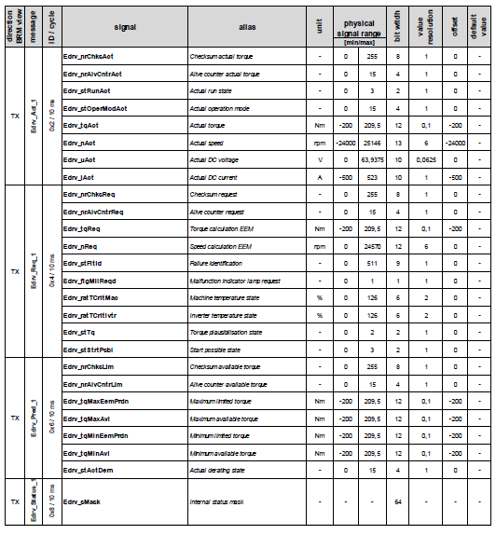
CAN communication – Transmitted signals(TX) from BRM
Header of section
Edrv_stRunAct | <Actual run state> Actual BRM run state 0x0 = Pre-Run 0x1 = Run (Idle, Torque, ...) 0x2 = Post-Run 0x3 = Post-Run finished
Edrv_stOperModAct | <Actual operation mode> Actual BRM operation mode 0x0 = Idle 0x1 = Torque mode 0x4 = Voltage mode 0x6 = Speed mode 0xB = Start mode 0xE = Standby ("Pre-Run", "Post-Run" or "Post-Run finished") 0xF = Failure
Edrv_tqAct | Actual estimated BRM torque at BRM shaft. The torque is calculated from internal measurement values of the BRM (speed, excitation current, phase currents). From BRM-perspective a positive value is a motor torque and a negative value is a generator torque.
Edrv_nAct | Actual measured BRM speed.
Edrv_uAct | Actual measured BRM DC link voltage between B+ and B- bolt.
Edrv_iAct | Actual estimated DC link current of the BRM at B+ bolt. Positive sign: current to BRM Negative sign: current from BRM
Edrv_ratTCritMac | Values between 75 % and 100 % lead to a torque derating to prevent the BRM from overheating in machine
Edrv_ratTCritIvtr | Values between 75 % and 100 % lead to a torque derating to prevent the BRM from overheating in inverter
Edrv_stActDern | <Actual derating state> Actual derating state of the BRM. Derating (power reduction) is active, if specific limit values (temperature, voltage or current) are reached. 0 = No derating 1 = Derating: DC voltage limitation 2 = Derating: DC current limitation 3 = Derating: torque limitation 4 = Derating: speed limitation 5 = Derating: inverter limitation 6 = Derating: motor temperature limitation 7 = Derating: phase current limit
5
SG/EEB3 | 2020-12-22
© SEG Automotive Germany GmbH 2020. All rights reserved, also regarding any disposal, exploitation, reproduction, editing, distribution, as well as in the event of applications for industrial property rights.

Slide 6
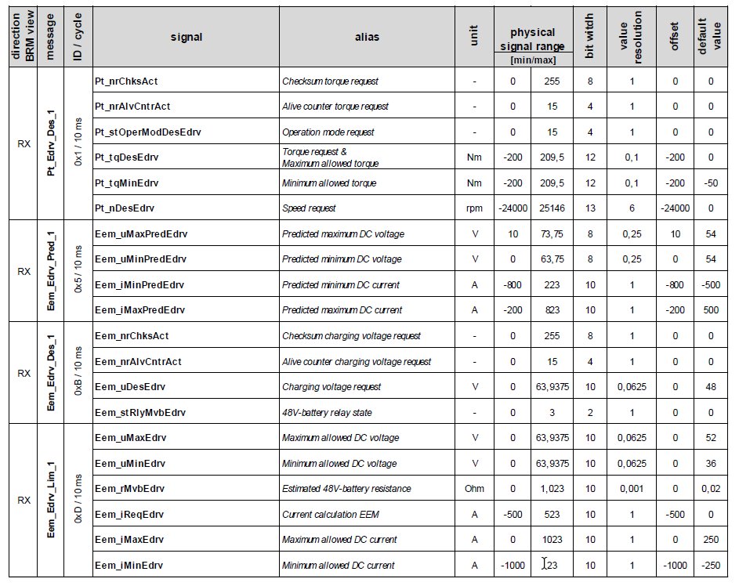
CAN communication – Received signals(RX) from BRM
Header of section
Signal name | Description | Default value
Pt_stOperModDesEdrv | Desired BRM operation mode: 0x0 = Idle 0x1 = Torque mode 0x4 = Voltage mode 0x6 = Speed mode 0xB = Start mode | 0
Pt_tqDesEdrv | Maximum allowed BRM torque at BRM shaft. This value is considered as maximum torque value in all active operation modes | 0
Pt_tqMinEdrv | Minimum allowed BRM torque at BRM shaft (maximum generator torque). This value is considered as minimum allowed torque limitation in all active operation modes | -50
Pt_nDesEdrv | Desired BRM speed at BRM shaft. Desired speed is considered as target value in speed mode | 0
Eem_uMaxEdrv | Maximum allowed DC voltage between B+ and B- bolt of the BRM. This limit will be considered as maximum voltage in the following operation modes: torque mode, speed mode and start mode | 52
Eem_uMinEdrv | Minimum allowed DC current at B+ bolt of the BRM. This limit will be considered as negative current in all active operation modes | 36
Eem_iMaxEdrv | Maximum allowed DC current at B+ bolt of the BRM. This limit will be considered as positive current in all active operation modes | 250
Eem_iMinEdrv | Minimum allowed DC voltage between B+ and B- bolt of the BRM. This limit will be considered as minimum voltage in the following operation modes: torque mode, speed mode and start mode | -250
6
SG/EEB3 | 2020-12-22
© SEG Automotive Germany GmbH 2020. All rights reserved, also regarding any disposal, exploitation, reproduction, editing, distribution, as well as in the event of applications for industrial property rights.

Slide 7
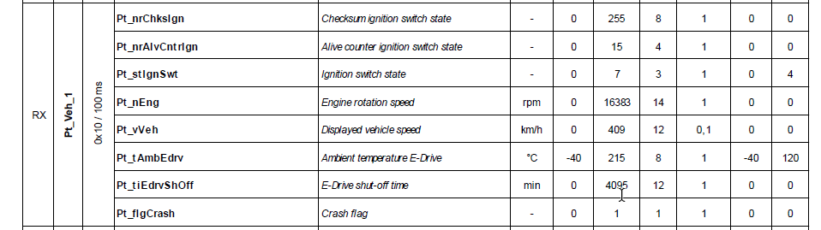
CAN communication – Received signals(RX) from BRM
Header of section
Signal name | Description | Default value
Pt_stIgnSwt | Ignition switch. This signal is used to control BRM run state: 0x0 = IGN_LOCK ("off") 0x1 = IGN_OFF ("off") 0x2 = IGN_ACC ("on") 0x4 = IGN_ON ("on") 0x5 = IGN_START ("on") | 4 (“on”)
7
SG/EEB3 | 2020-12-22
© SEG Automotive Germany GmbH 2020. All rights reserved, also regarding any disposal, exploitation, reproduction, editing, distribution, as well as in the event of applications for industrial property rights.

Slide 8
Start-up
Header of section
Take all default values for CAN signals according SW interface description page 11 and 12
  Check max/min current and max/min voltage from 48V power supply and set CAN signals accordingly
Take cycle time for CAN messages according SW interface description page 11 and 12
Connect 12V to logic connector AND 12V Ground to B- bolt
  BRM starts CAN communication
  Edrv_stOperModAct = 0xE (Standby)
  Edrv_stRunAct = 0x0 (Pre-Run)
Connect 48V to B+ and B- bolt
  With approx. 24V Edrv_stOperModAct changes from 0xE (Standby) to 0x0 (Idle) and Edrv_stRunAct changes from 0x0 (Pre-Run) to 0x1 (Run)
  You can see actual voltage (Edrv_uAct) on B+ / B- bolt
Initialization done
8
SG/EEB3 | 2020-12-22
© SEG Automotive Germany GmbH 2020. All rights reserved, also regarding any disposal, exploitation, reproduction, editing, distribution, as well as in the event of applications for industrial property rights.

Slide 9
Operation mode
Header of section
Check maximum/minimum allowed 48V voltage from outside (battery/power supply) and set Eem_uMaxEdrv and Eem_uMinEdrv Check maximum/minimum allowed 48V current from outside (battery/power supply) and set Eem_iMaxEdrv and Eem_iMinEdrv
For torque mode Change Pt_stOperModDesEdrv from 0x0 (idle) to 0x1 (Torque) Change Pt_trqDesEdrv from 0Nm to (when nothing is mounted on BRM) 1Nm CAUTION: BRM will turn!!! | For speed mode Change Pt_trqDesEdrv from 0Nm to (when nothing is mounted on BRM) 1Nm This will be the max possible torque to get requested speed Change Pt_nDesEdrv from 0rpm to (for example) 1000rpm Change Pt_stOperModDesEdrv from 0x0 (idle) to 0x6 (speed) CAUTION: BRM will turn at 1000rpm
9
SG/EEB3 | 2020-12-22
© SEG Automotive Germany GmbH 2020. All rights reserved, also regarding any disposal, exploitation, reproduction, editing, distribution, as well as in the event of applications for industrial property rights.

Slide 10
Shut down
Header of section
Set signal Pt_stIgnSwt to 0x0 (“Off”)
  Edrv_stOperModAct will go to 0xE (Standby) and Edrv_stRunAct goes to 0x2 (Post Run) and 0x3 (Postrun finished)
Switch off 48V and 12V supply
Error handling
  In case an error happen signal Edrv_stOperModAct will go to 0xF (“Failure”)
  It is possible to read the failure via Unified Diagnostic Service (UDS) on the CAN
    For further information read SW interface description chapter 7 (Page 42)
10
SG/EEB3 | 2020-12-22
© SEG Automotive Germany GmbH 2020. All rights reserved, also regarding any disposal, exploitation, reproduction, editing, distribution, as well as in the event of applications for industrial property rights.

Slide 11
Header of section
Let test it!!!
11
SG/EEB3 | 2020-12-22
© SEG Automotive Germany GmbH 2020. All rights reserved, also regarding any disposal, exploitation, reproduction, editing, distribution, as well as in the event of applications for industrial property rights.

